Slide 1
Projects In Express
What is Socket.io?

Slide 2
What Is Socket.io?
JavaScript library for realtime web applications
Enables realtime bi-directional communication between client and server
2 parts – client side library that runs in the browser and server side library for Node.js

Slide 3
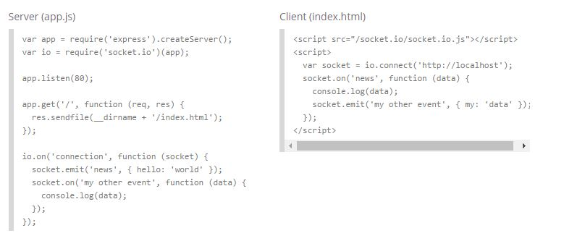
How It Works

Slide 4


